Slide 1
OAUTH Workflow

Slide 2
Commenting on a Blog Post
JavaWorld.com
End User
Google
Login

Slide 3
JavaWorld Registers with Google and gets a client ID
Java world Redirects
http://googleapis.com/oauth?client_id=javaworld&state=12345670987&redirect_uri=http%3A%2F%2Fjavaworld.com
User Logs In
Google Authenticates and redirects
http://javaworld.com/state=12345670987&code=0002222

Slide 4
JavaWorld —-> code=0002222 —> Google
JavaWorld <——— Token= 2b8937893849342341bc234123612341234123412abc <—— Google
JavaWorld ———> Token= 2b8937893849342341bc234123612341234123412abc ——> Google

Slide 5

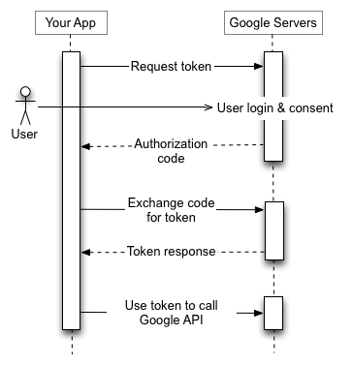

Slide 6
Roles:
JavaWorld.com
End User
Client
Google
Login
Resource Owner
Resource Server
Authorization Server

Slide 7
Variation in implementation
OAuth Support

